Slide 1
Stored Procedure, Transactions and Triggers Name -Rajas Hemant Doshi

Slide 2
What is a Stored Procedure?
A stored procedure is a set of SQL commands that are saved in the database. You can call (or execute) this procedure whenever needed to perform a specific task like retrieving or modifying data.
Calling a stored procedure means running the saved set of instructions without rewriting them each time.
Key Characteristics:
Written in SQL or a database-specific language (e.g., PL/SQL, T-SQL).
Can accept input values and return results.
Usage:
Simplifies repetitive tasks.
Improves performance by running the logic on the server rather than in each application.

Slide 3
Why Use Stored Procedures & Their Advantages
Faster Performance:
Stored procedures are precompiled, so they run faster.
Reduces the need to send multiple queries across the network.
Better Security:
Protects data by controlling access.
You can give users permission to run procedures without giving access to sensitive data.
Reusability:
Once created, stored procedures can be used again and again in different applications.
Easier Maintenance:
Changes can be made in one place instead of in every query.
Keeps your code clean and organized.
Consistency:
Ensures that the same operations are performed in the same way every time.

Slide 4
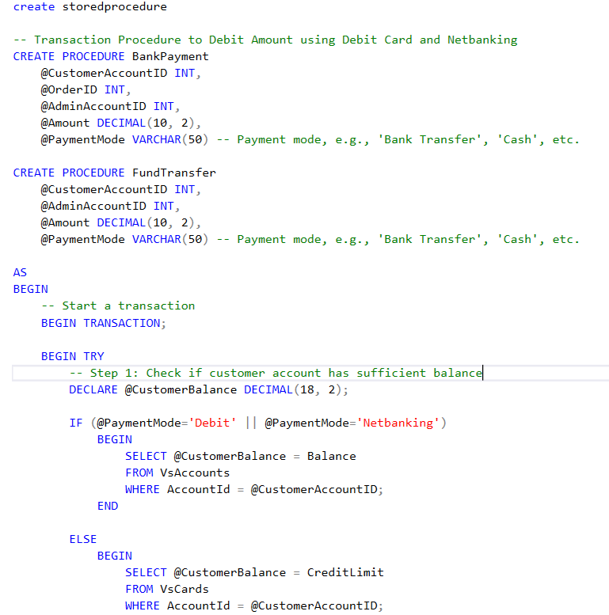
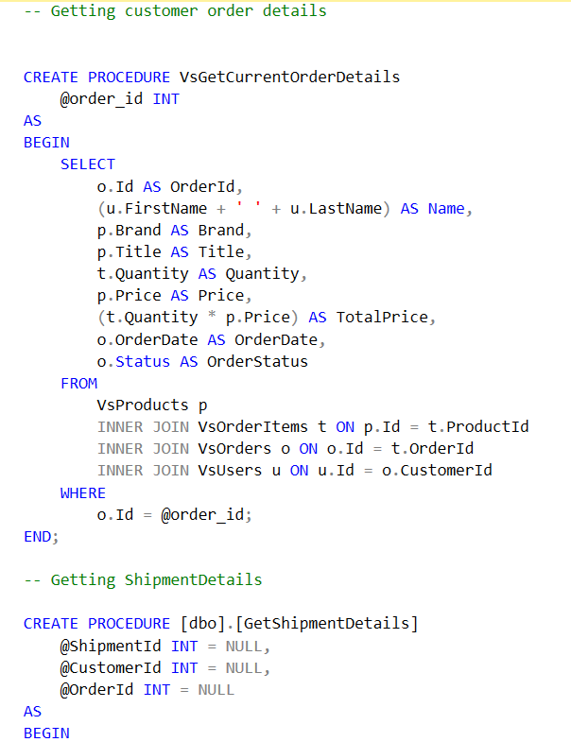
Stored Procedures in Our E-Commerce Application

Slide 5
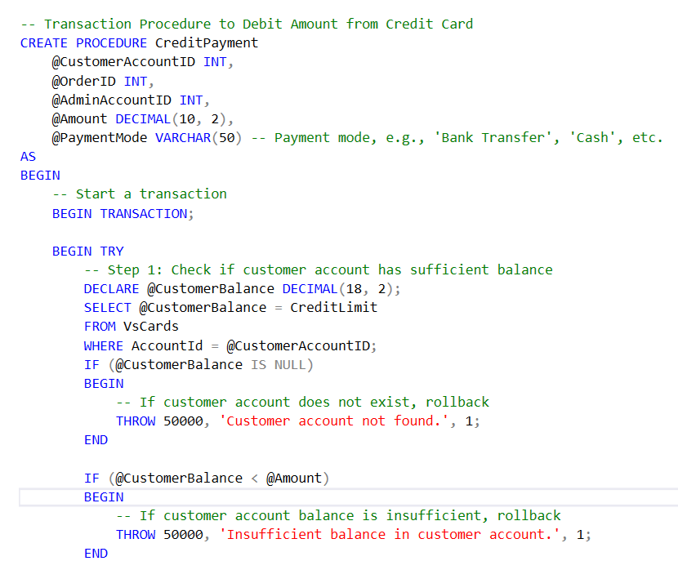
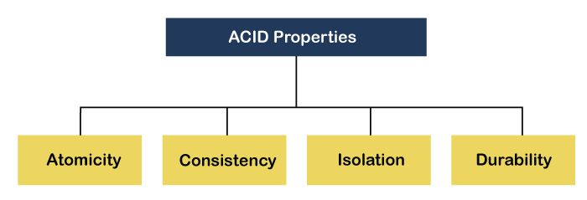
What is a Database Transaction?
A database transaction is a logical unit of work that consists of one or more database operations (like insert, update, delete) executed as a single unit.
It ensures that the operations either complete entirely or have no effect at all, maintaining data integrity.

Slide 6
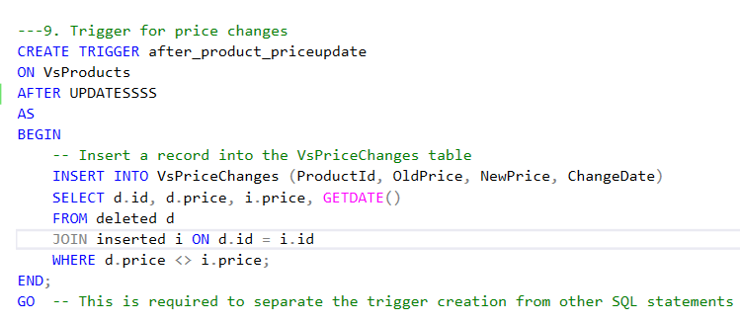
What is a Database Trigger?
A trigger is a database object that automatically executes or fires when certain events occur, such as inserting, updating, or deleting data in a table. It helps to automate tasks and maintain data consistency without manual intervention.
Why Use Triggers?
To enforce business rules and data integrity.
To automate tasks like updating related tables or logging changes.
Advantages of Database Triggers
Automation
Data Integrity
Security
Auditability
Consistency

Slide 7




THANK YOU
(844) 720-6678
info@simplifyhealthcare.com
simplifyhealthcare.com
Simplify Healthcare
U.S.: 600 N Commons Drive, Suite 110, Aurora, IL 60504
India: 401/402, 4th Floor, Pentagon P-2, Magarpatta City, Pune 411013
CONNECT WITH US
LinkedIn
YouTube
X
Instagram

